Slide 1
Cash and Financial Assets - Accounting Principles
2022. 4.
Dr. Yangin Yoon

Slide 2
Recap the last class
When they buy goods:
When they sell all the goods:
→ What if they sell just half of the goods?
What if they bought goods multiple times?
Inventory $5,000
Cash $5,000
Cash $8,000
Revenue $8,000
Cost of goods $5,000
Inventory $5,000

Slide 3
Recap the last class
Accounting for Merchandising Firms
- Inventory valuation
First-in, first out (FIFO)
Last-in, first-out (LIFO)
Weighted-Average Cost

Slide 4
Recap the last class
IAS 2 (Inventories)
- Paragraph 23
23. The cost of inventories of items that are not ordinarily interchangeable and goods or services produced and segregated for specific projects shall be assigned by using specific identification of their individual costs.
K-IFRS 1002 Inventory
23. 통상적으로 상호 교환될 수 없는 재고자산항목의 원가와 특정 프로젝트별로 생산되고 분리되는 재화 또는 용역의 원가는 개별법을 사용하여 결정한다.

Slide 5
Recap the last class
IAS 2 (Inventories)
- Paragraph 24
24. Specific identification of cost means that specific costs are attributed to identified items of inventory. This is the appropriate treatment for items that are segregated for a specific project, regardless of whether they have been bought or produced. However, specific identification of costs is inappropriate when there are large numbers of items of inventory that are ordinarily interchangeable. In such circumstances, the method of selecting those items that remain in inventories could be used to obtain predetermined effects on profit or loss.

Slide 6
Any Questions?

Slide 7
Cash and Internal Control
Cash
- Cash is essential in operating business
- Cash should be monitored carefully
(For example, which items should be monitored more carefully?
Cash, diamond, building, large machinery, land, bolts and nuts?)
Internal control
- Segregation of duties
- Inventory management, sales activity, receivable collection, accounting department

Slide 8
Financial Asset
Financial Asset
- IAS 32 Paragraph 11
- A financial asset is any asset that is:
(a) cash;
(b) an equity instrument of another entity;
(c) a contractual right:
(d) a contract that will or may be settled in the entity’s own equity instruments with some consition(s)
Common example
- Investing stocks or bonds
- IAS 28 is also related.

Slide 9
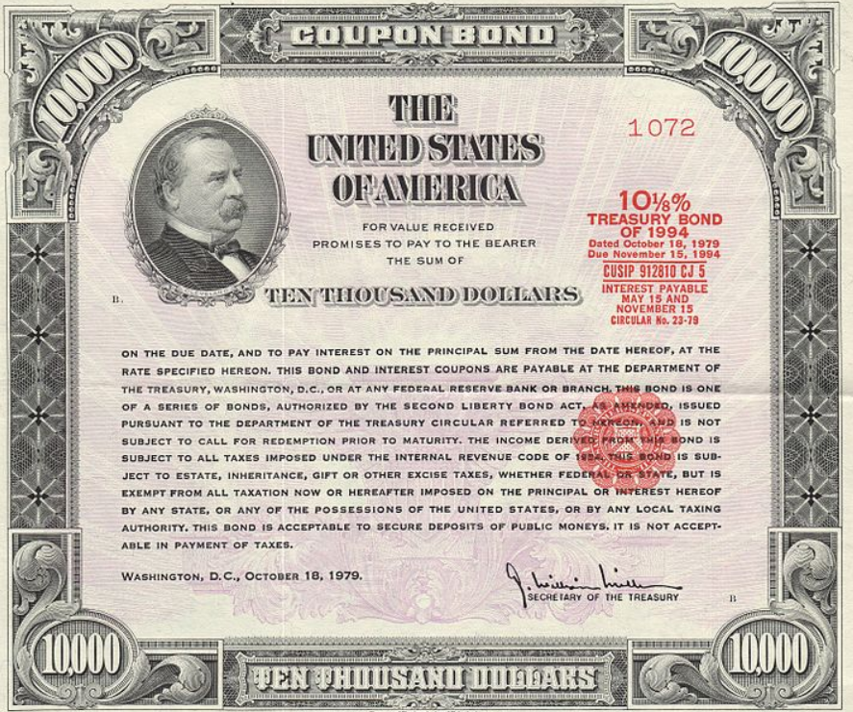
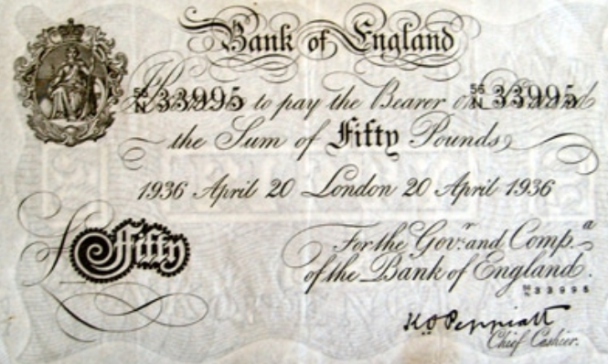
Financial Asset
Stock
- Equity of other company
Bond
- Future payments of principal and interest on the principal amount outstanding

Slide 10
Financial Asset
When the company acquires financial assets,
(recognition journal entry)
When it sells all the financial assets:
or
Financial assets XXX
Cash XXX
Cash YYY
Financial assets XXX
Gains on disposal of FA YYY - XXX
Cash YYY
Financial assets XXX
Loss on disposal of FA XXX - YYY

Slide 11
Financial Asset
When the company acquires financial assets,
(recognition journal entry)
When it sells all the financial assets:
→ How to report in the end of each accounting period?
(If the company holds the Financial assets more than one year)
Historical value (cost) or market value?
Financial assets XXX
Cash XXX
Cash YYY
Financial assets XXX
Gains on disposal of FA YYY - XXX

Slide 12
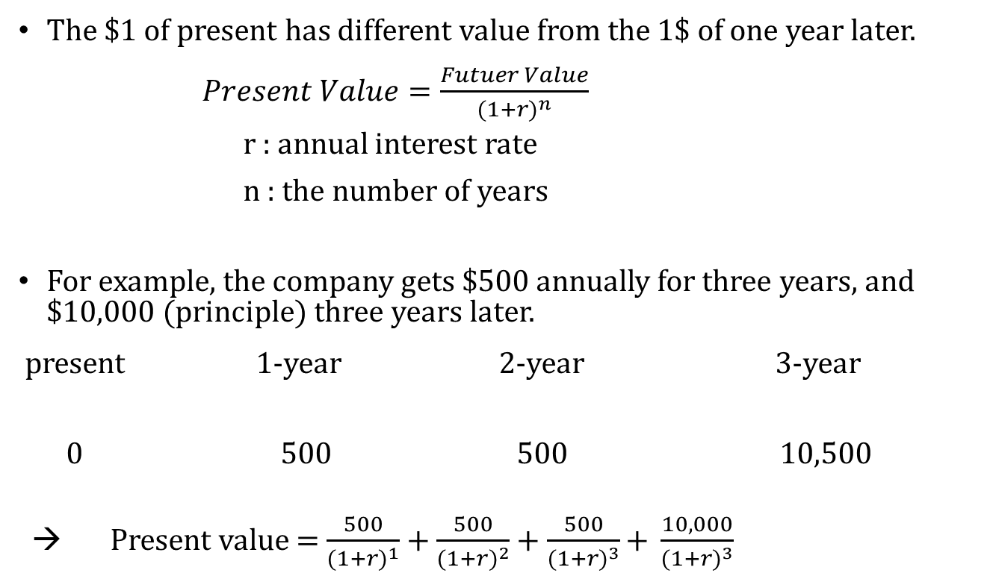
Time Value of Money
The $1 of present has different value from the 1$ of one year later.
$Present Value=\frac{Futuer Value}{{(1+r)}^{n}}$
r : annual interest rate
n : the number of years
For example, the company gets $500 annually for three years, and $10,000 (principle) three years later.
present 1-year 2-year 3-year
0 500 500 10,500
→ Present value = $\frac{500}{{(1+r)}^{1}}$ + $\frac{500}{{(1+r)}^{2}}$ + $\frac{500}{{(1+r)}^{3}}\text{+ }\frac{10,000}{{(1+r)}^{3}}$

Slide 13

Time Value of Money
For example, the company gets $500 annually for three years, and $10,000 (principle) three years later.
- The current annual interest rate is 6%. What is the fair value of this cash flow?
→ Present value = $\frac{500}{{(1+0.06)}^{1}}$ + $\frac{500}{{(1+0.06)}^{2}}$ + $\frac{500}{{(1+0.06)}^{3}}$ + $\frac{10,000}{{(1+0.06)}^{3}}$= 9,733
 | 2022.1.1. | 2022.12. | 2023.12 | 2024.12 | Sum of three years
Nominal amount | 0 | 500 | 500 | 10,500 | 11,500
Interest rate | 0.06
Discount factor | 1 | 0.943 | 0.890 | 0.840
Present Value | 0 | 472 | 445 | 8,816 | 9,733

Slide 14
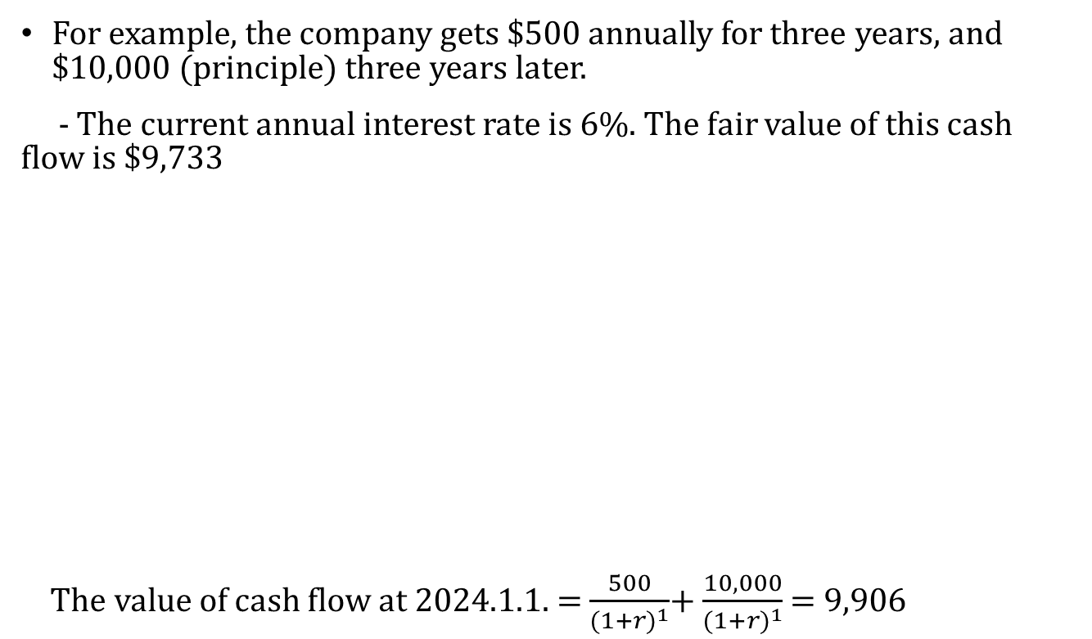
Time Value of Money
For example, the company gets $500 annually for three years, and $10,000 (principle) three years later.
- The current annual interest rate is 6%. The fair value of this cash flow is $9,733
The value of cash flow at 2024.1.1. = $\frac{500}{{(1+r)}^{1}}$+ $\frac{10,000}{{(1+r)}^{1}}$ = 9,906
 | Value before the interest payment (A) | Small payback (B) | Value after payment (C=A-B)
2022.1.1. | 9,733 | - | 9,733
2022.12.31. | 10,317 (=9733*1.06) | 500 | 9,817
2023.12.31. | 10,406 (=9817*1.06) | 500 | 9,906
2024.12.31. | 10,500 (=9906*1.06) | 500 | 10,000

Slide 15
Time Value of Money
2022.1.1.
2022.12.31.
9,733*0.06 = 584
2023.12.31.
9,817*0.06 = 589
 | Value before the interest payment (A) | Small payback (B) | Value after payment (C=A-B)
2022.1.1. | 9,733 |  | 9,733
2022.12.31. | 10,317 (=9733*1.06) | 500 | 9,817
2023.12.31. | 10,406 (=9817*1.06) | 500 | 9,906
2024.12.31. | 10,500 (=9906*1.06) | 500 | 10,000
Financial Assets 9,733
Cash 9,733
Financial Assets 84
Cash 500
Interest income 584
Financial Assets 89
Cash 500
Interest income 589

Slide 16
Time Value of Money
2024.12.31.
9,906*0.06 = 594
 | Value before the interest payment (A) | Small payback (B) | Value after payment (C=A-B)
2022.1.1. | 9,733 |  | 9,733
2022.12.31. | 10,317 (=9733*1.06) | 500 | 9,817
2023.12.31. | 10,406 (=9817*1.06) | 500 | 9,906
2024.12.31. | 10,500 (=9906*1.06) | 500 | 10,000
Financial Assets 94
Cash 500
Interest income 594
Cash 10,000
Financial Assets 10,000

Slide 17
Time Value of Money - Summary
2022.1.1.
2022.12.31.
2023.12.31.
2024.12.31.
→ Financial Assets = 9,733 + 84 + 89 + 94 = 10,000
Total interest income for three years = 584 + 589 + 594 = 1,767 = 500*3 + (10,000 – 9733)
Financial Assets 9,733
Cash 9,733
Financial Assets 84
Cash 500
Interest income 584
Financial Assets 89
Cash 500
Interest income 589
Financial Assets 94
Cash 500
Interest income 594
Cash 10,000
Financial Assets 10,000

Slide 18
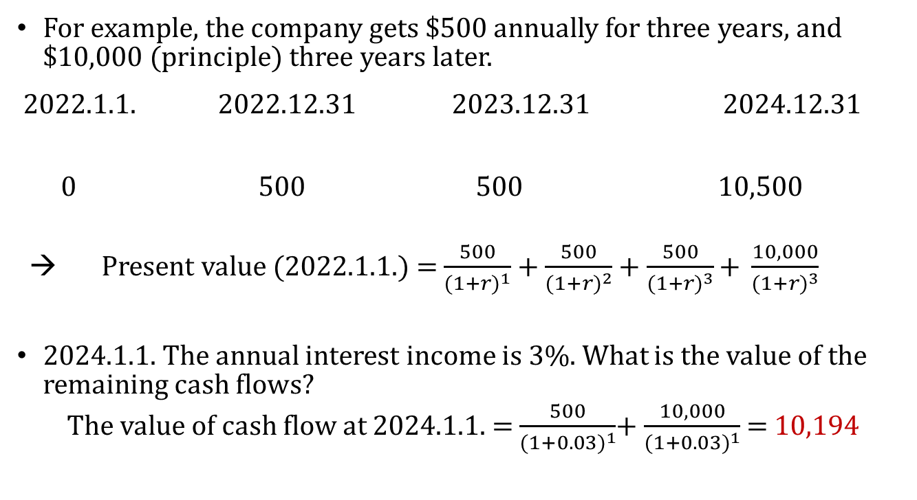
Re-valuation
For example, the company gets $500 annually for three years, and $10,000 (principle) three years later.
2022.1.1. 2022.12.31 2023.12.31 2024.12.31
0 500 500 10,500
→ Present value (2022.1.1.) = $\frac{500}{{(1+r)}^{1}}$ + $\frac{500}{{(1+r)}^{2}}$ + $\frac{500}{{(1+r)}^{3}}\text{+ }\frac{10,000}{{(1+r)}^{3}}$
2024.1.1. The annual interest income is 3%. What is the value of the remaining cash flows?
The value of cash flow at 2024.1.1. = $\frac{500}{{(1+0.03)}^{1}}$+ $\frac{10,000}{{(1+0.03)}^{1}}$ = 10,194

Slide 19
Re-valuation
2022.1.1.
2022.12.31.
2023.12.31.
2024.1. 1.
10194 – (9733 + 84 + 89 ) = 288
→ What is the book value of Financial Assets on 2024.1.1.?
9,733 + 84 + 89 + 288 = 10194
Financial Assets 9,733
Cash 9,733
Financial Assets 84
Cash 500
Interest income 584
Financial Assets 89
Cash 500
Interest income 589
Financial Assets 288
Gain 288

Slide 20
Re-valuation
2024.1. 1.
10194 – (9733 + 84 + 89 ) = 288
→ What if the company holds this bond until the maturity, what is the journal entry?
2024.12. 31.
10194 * 0.03 = 306
Financial Assets 288
Gain 288
Financial Assets 306
Interest Income 288
Cash 10500
Financial Assets 10500

Slide 21
Re-valuation & Disposal
2022.1.1.
2022.12.31.
2023.12.31.
2024.1. 1.
→ What if the company sell this bond with $10,300 on 2024.1.2.?
Financial Assets 9,733
Cash 9,733
Financial Assets 84
Cash 500
Interest income 584
Financial Assets 89
Cash 500
Interest income 589
Financial Assets 288
Gain 288
Cash 10,300
Financial Assets (FA) 10,194
Gain on disposal of FA 106

Slide 22
Financial Assets – Debt type assets
There are three types of accounting methods for debt type financial assets.
1) Amortized Cost (AC) Financial Assets
- Debt Securities for which the investors holds primarily to collect the interest and principal are measured at amortized cost
2) Fair Value Through Other Comprehensive Income (FVTOCI) Financial Assets
- Debt Securities that are held to collect interest and to sell before maturity are measured as fair value
3) Fair Value through Profit or Loss (FVTPL) Financial Assets
- Holding for selling in near future, and other cases

Slide 23
Equity Investment
Equity Investment
1) Fair Value Through Other Comprehensive Income (FVTOCI) Financial Assets
- Equity Securities for which the investor holds not for the trading purpose. In addition, the company choose to classify this as FVTOCI
2) Fair Value through Profit or Loss (FVTPL) Financial Assets
- Equity Securities that are held for the trading purpose
3) Investments in Associates (Using the Equity Method)
- When an investor has significant influence but not control over an investee, the investee is an associate
- Significant influence is presumed with a shareholding of between 20% and 50% of the voting rights.

Slide 24
Financial Assets & Equity Investment
We will study more in the next class

Slide 25
Any Questions?

Slide 26
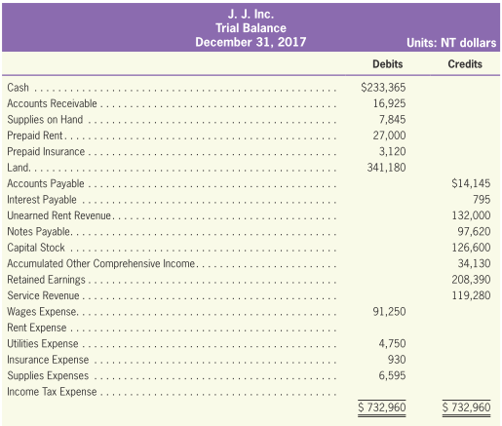
Trial Balance
Sample of Trial Balance

Slide 27
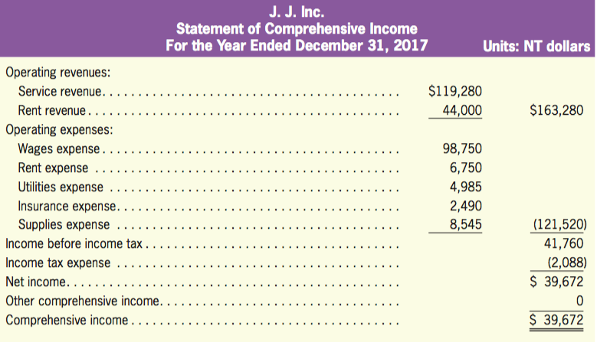
Income Statement
Sample of Income Statement

Slide 28
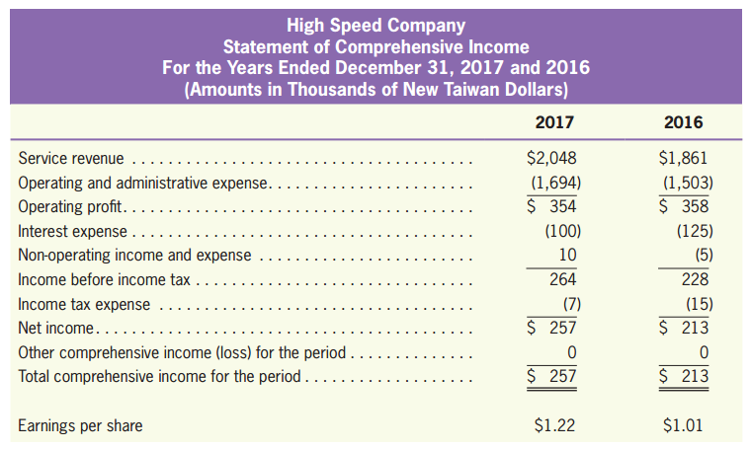
Income Statement
Sample of Income Statement

Slide 29
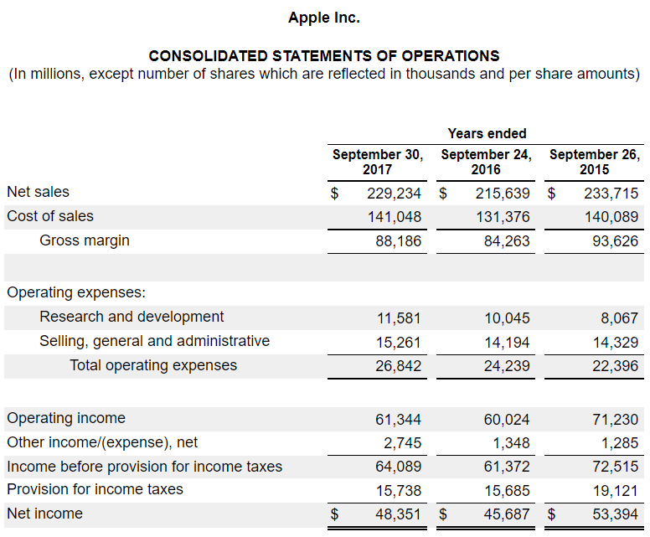
Income Statement
Sample of Income Statement

Slide 30
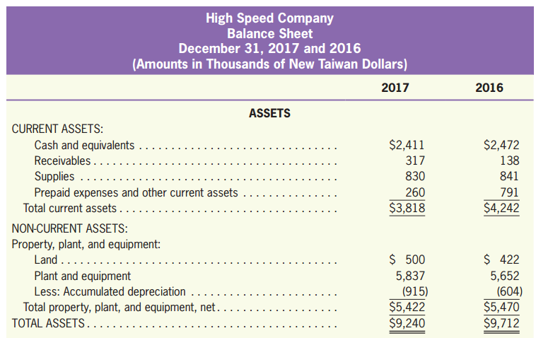
Balance Sheet (Statement of Financial Position)
Sample of Balance Sheet

Slide 31
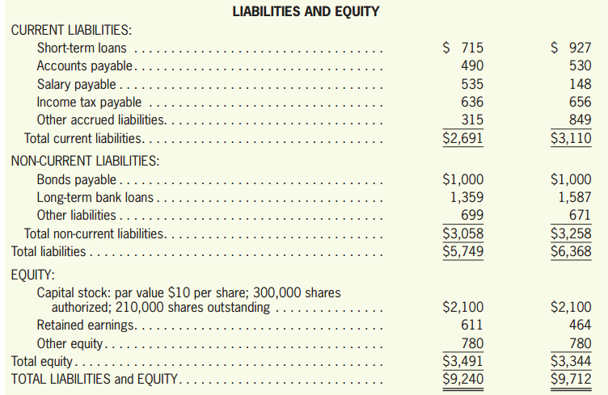
Balance Sheet (Statement of Financial Position)
Sample of Balance Sheet

Slide 32
Reading Material
Why global accounting standards?
https://www.ifrs.org/use-around-the-world/why-global-accounting-standards/
GAAP VS. IFRS: WHAT ARE THE KEY DIFFERENCES AND WHICH SHOULD YOU USE?
https://online.hbs.edu/blog/post/gaap-vs-ifrs
GAAP: What Are ‘Generally Accepted Accounting Principles’?
https://www.nerdwallet.com/article/small-business/gaap-generally-accepted-accounting-principles
What Are the Advantages and Disadvantages of Accrual Basis Accounting?
https://smallbusiness.chron.com/sole-proprietorship-business-handle-money-58370.html
https://connectusfund.org/6-advantages-and-disadvantages-of-accrual-basis-accounting
https://kapa21.or.kr/bbs/dictionary/6766

Slide 33
Any Questions?

